Slide 1
Tuesday, January 10, 2017
Write In Your Agenda:
Write In Your Monitoring Log:
CW:
Scientific Method: Observations.
HW:
None
Response to Warm-Up:
What is your New Year’s Resolution?
You will need:
Pencil
New Monitoring Log

Slide 2
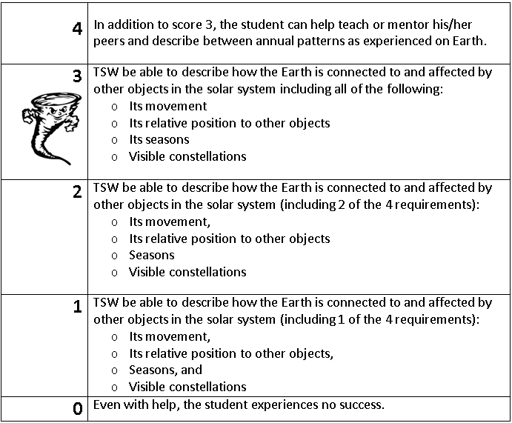
Learning Goal and Scale
TSW be able to describe how the Earth is connected to and affected by other objects in the solar system (including its movement, its relative position to other objects, its seasons, and visible constellations).

